Slide 1


KEY STAGE 3 KNOWLEDGE ORGANISER
POWER PACK
YEAR 9 – TERM 5

Slide 2

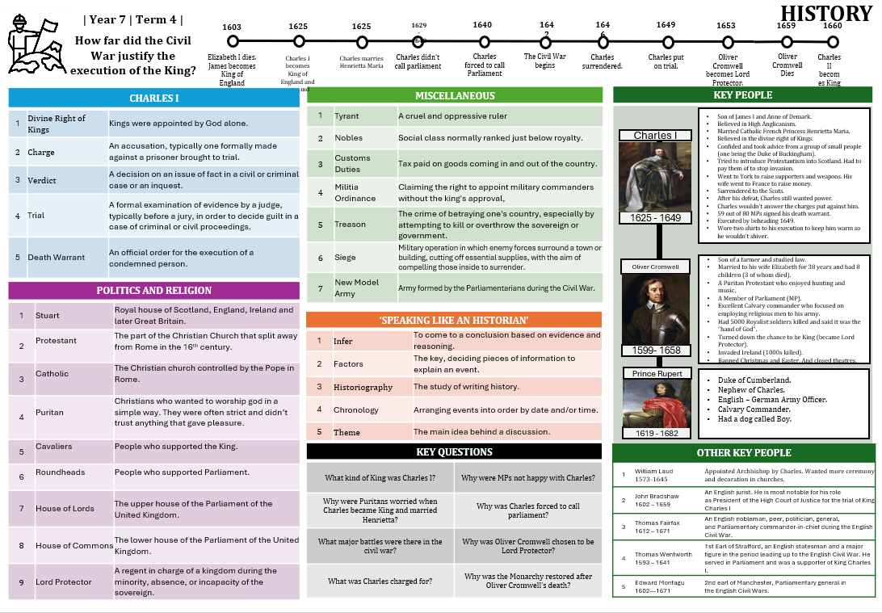
How do Knowledge Organisers support learning?
What are Knowledge Organisers?
Knowledge organisers are one-page documents that contain all of the key vocabulary and information needed to succeed at the highest level for a particular topic or unit. They are available to all in each department for every subject/qualification. They provide a clear reference point and a backbone of understanding to make learning focused and meaningful. They are printed and glued into exercise books at the start of each topic or unit. Additional copies can also be provided if required.
What do Knowledge Organisers look like?
Each Knowledge Organiser comprises of a range of colour-coded tables of key vocabulary, definitions, information and summaries with each table’s contents numbered. The colour-coding and numbering makes each piece of content easily identifiable and ensures that learning is incremental and manageable. All Knowledge Organisers provide information about the Year, Topic/Unit Question and Term. There are also subtle differences that relate to subject-specific requirements.

Slide 3
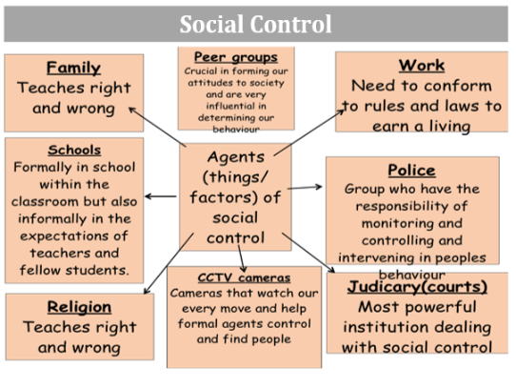
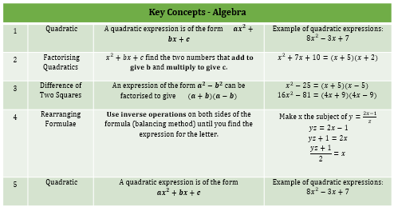
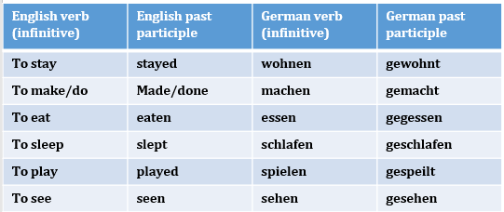
Why are Knowledge Organisers important?
Having all of this key information in one place makes it easily accessible before during and after the study of a particular unit or topic. Teachers continuously refer to the content of Knowledge Organisers within lessons and to support independent learning where they can be used to develop and consolidate knowledge. Therefore, Knowledge Organisers form the backbone of learning across the academy.
How do teachers use Knowledge Organisers?
Each department has carefully created each Knowledge Organiser so that it is individually tailored to the curriculum taught at North Kesteven. Teachers have selected the most key building blocks (knowledge and information) for each topic or unit provide clear support to develop knowledgeable and skilled subject experts. The knowledge and information contained on the Knowledge Organiser is carefully shared, identified and practised within and beyond lessons to develop confidence and fluency.
How do students use Knowledge Organisers?
There is regular testing within lessons on the understanding of the content of each Knowledge Organiser – this is carefully designed into the sequencing of the curriculum and lessons to gradually build and develop rather than overwhelm. Regular independent learning is structured around Knowledge Organisers. The real beauty of the Knowledge Organiser is its ability to support students and parents independently outside of lessons.

Slide 4
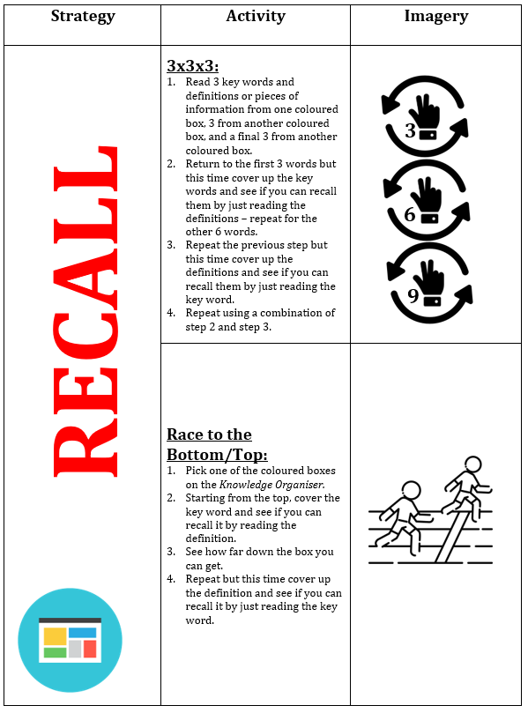
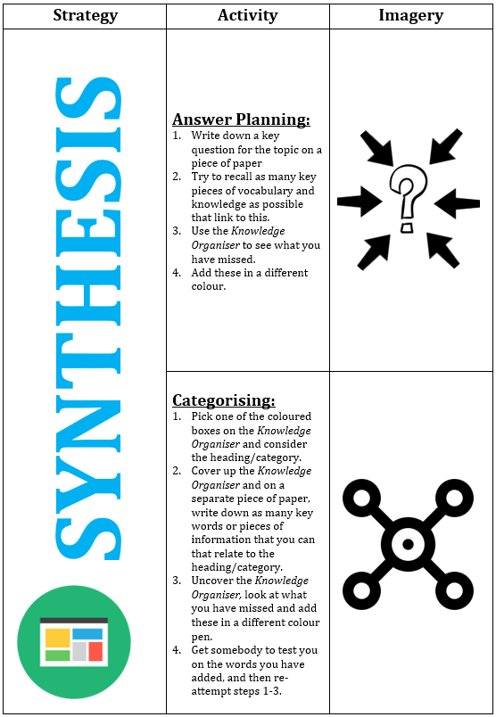
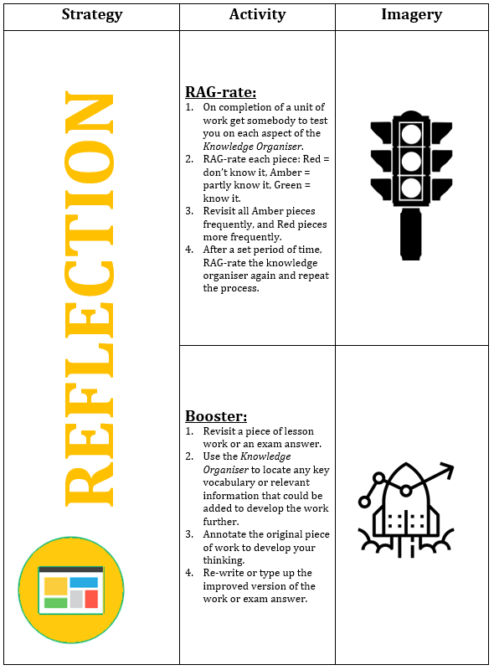
- SUPER6 STRATEGIES -
RECALL – these two strategies focus on your ability to bring knowledge, vocabulary and key information to mind quickly.
SYNTHESIS – these two strategies focus on applying your knowledge to show your thinking, understanding and reasoning.
REFLECTION – these two strategies focus on improving your existing knowledge and understanding by developing it further.

Slide 5
Year 9 | Term 5 ‘The Tempest’ by William Shakespeare |
ENGLISH
# | Character | Their role
1 | Prospero | The play’s protagonist, and father of Miranda.
2 | Miranda | The daughter of Prospero.
3 | Ariel | Prospero’s spirit helper.
4 | Caliban | Another of Prospero’s servants.
5 | Ferdinand | Son and heir of Alonso.
6 | Alonso | King of Naples and father of Ferdinand.
7 | Sebastian | Alonso’s brother.
8 | Antonio | Prospero’s brother and Miranda’s uncle.
9 | Gonzalo | An old, honest lord.
10 | Trinculo & Stephano | Trinculo, a jester, and Stephano, a drunken butler, are two minor members of the shipwrecked.
# | Area of Context | Further information
1 | William Shakespeare | Born in 1564 in Stratford-upon-Avon, William Shakespeare received a grammar school education but did not pursue formal studies further; he married Anne Hathaway in 1582 and had three children. Around 1590, Shakespeare moved to London, achieving success as a playwright and actor, eventually becoming part-owner of the Globe Theatre and a favourite of both Elizabeth I and James I. Shakespeare retired wealthy and famous to Stratford-upon-Avon, where he died in 1616 at the age of 52.
2 | Slavery | Slavery is a central theme in The Tempest, with various forms of servitude creating tension throughout the play. Ariel, an airy spirit, is bound to Prospero’s will and promised freedom if he performs his duties, including entrancing the island's visitors. Caliban, depicted as villainous, is also enslaved by Prospero, who took the island from him and maintains control through threats and punishment.
3 | Where the play came from | The Tempest was written around 1610–1611, reflecting the era's fascination with exploration, colonisation, and encounters with indigenous peoples, inspired partly by the 1609 shipwreck of the Sea Venture. The play explores themes of survival, power, and control, set against the backdrop of the "New World" and European expansion. The supernatural is central, with Prospero's magic and Ariel's mysticism symbolising Renaissance beliefs in unseen forces and humanity’s curiosity about the unknown.
4 | Colonialism | The Tempest was written during the Elizabethan era, a time of European exploration and colonisation in regions like the Americas, Africa, and Asia. Colonisation was often justified by portraying indigenous peoples as "savages" needing civilisation, a view reflected in the play. Caliban symbolises colonised peoples, with his treatment by Prospero illustrating themes of control and exploitation.
# | Plot
1. | Brief synopsis | The Tempest is a play about magic, betrayal, love, and forgiveness, set on an island where Prospero, the ex-Duke of Milan, lives with his daughter, Miranda, and magical creatures. The story unfolds with a storm, a plot to murder the King of Naples, and a romance between Miranda and Ferdinand, culminating in forgiveness and a return home.
2. | Key events | • A ship is caught in a tempest and begins to sink. • Prospero tells Miranda that he caused the storm. • Ariel fetches Ferdinand, who falls in love with Miranda. • Antonio and Sebastian plot to kill Alonso, the King of Naples. • The ship’s jester and butler meet Caliban and feed him alcohol. • Caliban suggests that they should kill Prospero, and Ariel overhears. • Prospero uses magic to scare Alonso and spoil Caliban’s plot. • Prospero’s daughter, Miranda, marries the son of King Alonso. • Prospero forgives the passengers for their former betrayals.
# | Key vocabulary | Definition
1 | Tempest | The violent storm conjured by Prospero to shipwreck his enemies on the island, setting the play’s events in motion.
2 | Usurpation | The wrongful seizure of power, exemplified by Antonio’s betrayal of Prospero.
3 | Reconciliation | The process of forgiveness and mending relationships, which is key to the play’s resolution.
4 | Colonisation | The process by which a country establishes control over a foreign territory, often exploiting its resources and imposing its culture and governance on the indigenous people.
5 | Redemption | The act of atoning for past wrongs or mistakes, seeking forgiveness, and achieving moral or spiritual recovery.
# | Themes
1. | Freedom and Slavery | The play explores themes of freedom and imprisonment, with the island acting as a trap where characters, following the shipwreck, have no immediate escape.
2. | Empathy and Forgiveness | Empathy, the ability to understand others' feelings, is key to forgiveness, and in The Tempest, some characters display it while others are self-absorbed.
3. | Nature Vs Nurture: | The Tempest explores nature versus nurture, contrasting the island's natural beauty with characters like Miranda, symbolising innocence, and Caliban, representing savagery.

Slide 6
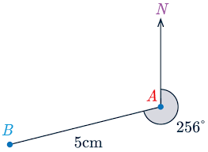
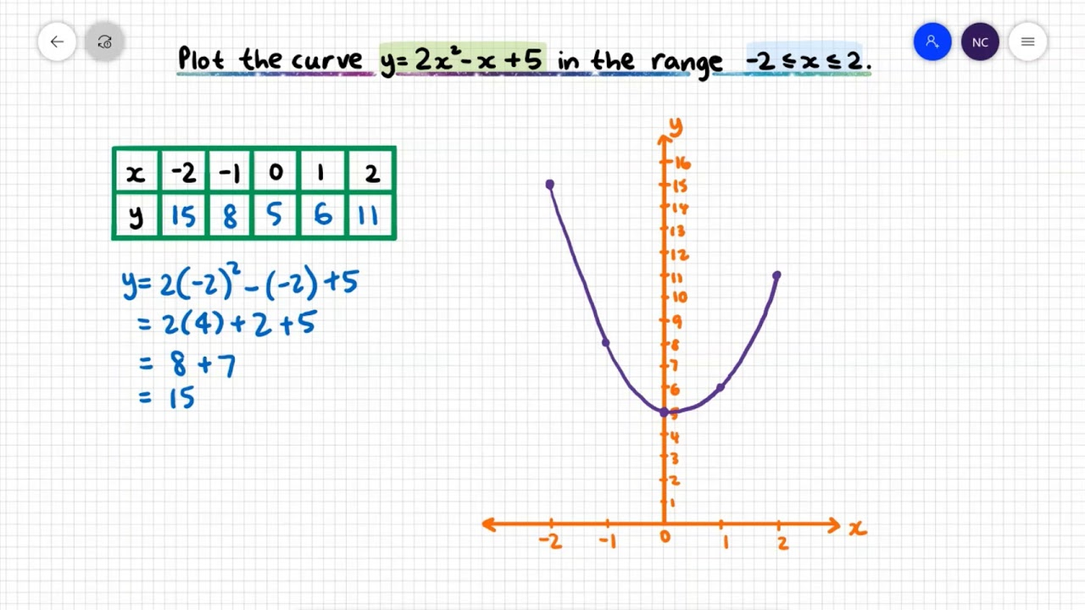
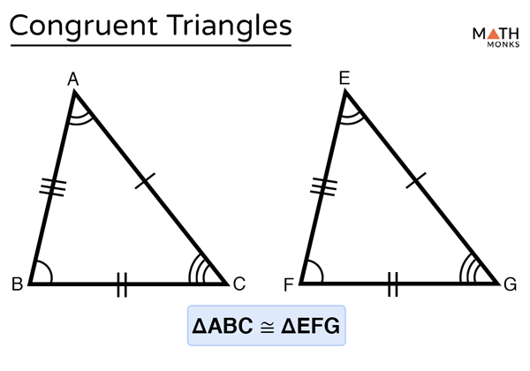
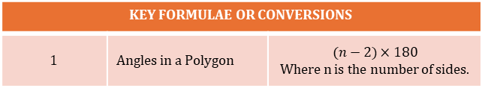
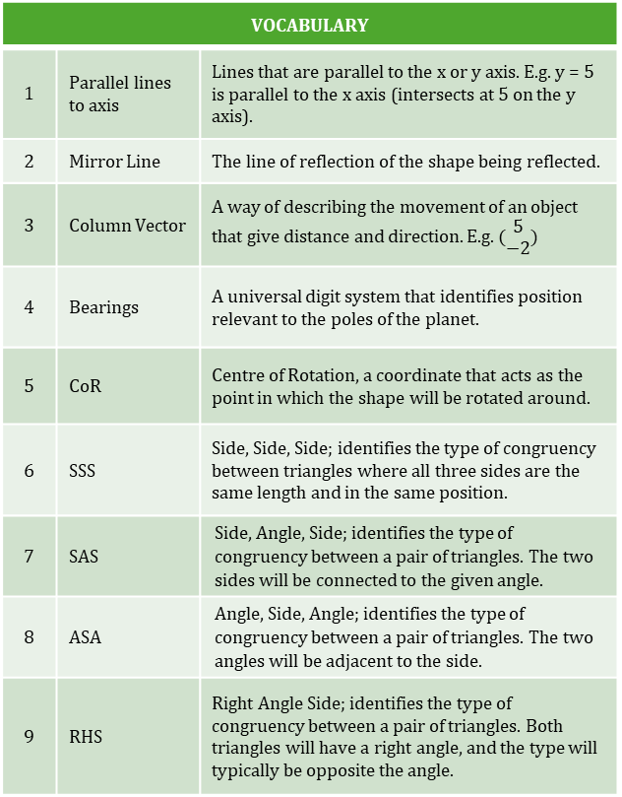
Year 9 | Term 5 | Quadratic Graphs, Angles and Bearings, Transformations and Similarity and Congruence
MATHS
CALCULATION RULES
1 | Quadratic Graphs | Unlike linear graphs, quadratic graphs will ALWAYS be a smooth curve in the shape of a ∪. If the squared variable is negative, it will be a ∩.
2 | Quadratic graph solutions | Quadratic graphs can have multiple solutions, the solutions are where the curve intersects the x axis.
3 | Alternate Angles | Angles that occur on opposite sides of the transversal line are equal.
4 | Corresponding Angles | Angles that occur on the same side of the transversal line and are equal in size.
5 | Co-Interior | A pair of internal angles on the transversal line sum to 180°.
6 | Bearings | Three rules of bearings: Bearings will always have 3 DIGITS, They are measured from the NORTH, and they are measured CLOCKWISE.
7 | Translation | Moves a shape with a column vector that describes distance and direction.
8 | Reflection | Uses linear lines (usually parallel to the axis) or y=x/y=-x.
9 | Rotation | Rotating a shape has 3 pieces of information; CoR, DIRECTION and DISTANCE.
10 | Enlargement | Does not mean the shape always gets bigger, enlargement is based on the scale factor. Fractional scale factors lead to smaller shapes.
11 | Congruent Triangles | Angle sizes NEVER change between congruent shapes. Four types of triangular congruency; SSS, SAS, ASA and RHS.
BEARING OB FROM A
VOCABULARY
1 | Parallel lines to axis | Lines that are parallel to the x or y axis. E.g. y = 5 is parallel to the x axis (intersects at 5 on the y axis).
2 | Mirror Line | The line of reflection of the shape being reflected.
3 | Column Vector | A way of describing the movement of an object that give distance and direction. E.g. $(\begin{matrix}5 \\ −2\end{matrix})$
4 | Bearings | A universal digit system that identifies position relevant to the poles of the planet.
5 | CoR | Centre of Rotation, a coordinate that acts as the point in which the shape will be rotated around.
6 | SSS | Side, Side, Side; identifies the type of congruency between triangles where all three sides are the same length and in the same position.
7 | SAS | Side, Angle, Side; identifies the type of congruency between a pair of triangles. The two sides will be connected to the given angle.
8 | ASA | Angle, Side, Angle; identifies the type of congruency between a pair of triangles. The two angles will be adjacent to the side.
9 | RHS | Right Angle Side; identifies the type of congruency between a pair of triangles. Both triangles will have a right angle, and the type will typically be opposite the angle.
QUADRATIC GRAPH
IDENTIFYING CONGRUENCY IN TRIANGLES
STEP BY STEP
1 | Work out the size of an internal angle for a regular dodecagon. | Dodecagon = 12 sides (12-2) x 180 = 1800 1800 ÷ 12 = 150°
KEY FORMULAE OR CONVERSIONS
1 | Angles in a Polygon | $$(n−2)×180$$ Where n is the number of sides.

Slide 7
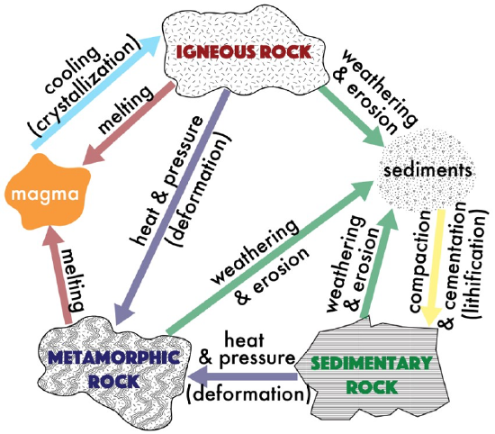
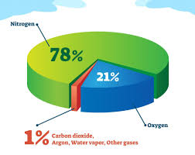
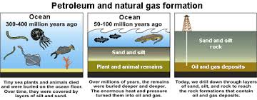
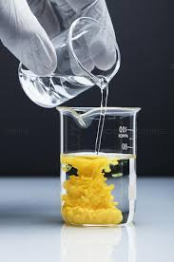
| Year 9 | Term 5 | Why can you not find every type of fossil in all kinds of rock?
SCIENCE
THE THREE TYPES OF ROCK
1 | Sedimentary rock | This is formed from the compression of sediments (may include fossils).
2 | Igneous rock | Rock formed by the cooling of lava.
3 | Metamorphic rock | Rock changed by heat and pressure.
THE ROCK CYCLE
KEY VOCABULARY
1 | Weathering | The wearing down (breaking) of rocks by biological, chemical or physical processes.
2 | Expansion | An increase in volume when solids get hotter or when water freezes.
3 | Freeze-thaw | A physical weathering process where water in cracks freezes and expands.
4 | Erosion | The breakdown and removal of rock material by water, wind or moving ice.
5 | Sediment | A material deposited by water, wind or ice or salts left by evaporation.
6 | Deposition | The process of grains settling out from slowing water or wind, or as ice melts.
7 | Compaction | Sediment grains becoming compacted, during burial.
8 | Cementation | Sediment grains are stuck together by minerals, turning sediment into rock.
9 | Strata | Strata are layers of sedimentary rock.
10 | Fossils | The mineralised remains of once-living organisms, or footprints, shells, faeces.
11 | Mineral | A crystal-like structure of elements or compound; the “building blocks” of rocks.
12 | Organic matter | Matter from living organisms; contains carbon chains with hydrogens attached.
13 | Hydrocarbons | Molecules which are made up of carbon and hydrogen atoms only.
14 | Plankton | Plankton are microscopic, aquatic plants and animals.
15 | Decomposition | The breakdown of dead organic matter by microorganisms.
16 | Combustion | An exothermic reaction which uses oxygen to release heat.
KEY POINTS ABOUT THE ROCK CYCLE
1 | Rocks are gradually recycled, which means that we do not have rocks from every age of the Earth.
2 | The Rock Cycle takes place over millions of years.
KEY POINTS ABOUT CLIMATE CHANGE
1 | Greenhouse gases contribute to global warming by reducing the amount of radiation leaving Earth’s atmosphere.
2 | Global warming is the increase in global temperatures caused by higher levels of greenhouse gases.
EARTH’S ATMOSPHERE
. 78% Nitrogen gas (N₂) 21% Oxygen (O₂) 1% Argon (Ar) ~0.04% Carbon dioxide
THE FORMATION OF FOSSIL FUELS
PRECIPITATION
. An insoluble solid (precipitate) formed when two solutions react.
RELATED IMPORTANT PROCESSES
1 | Respiration | The process of using glucose and oxygen to provide energy for life.
2 | Photosynthesis | Converting water and carbon dioxide into glucose using energy from sunlight.

Slide 8
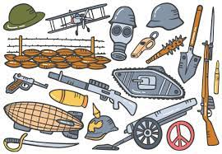
1895
1909-10
1928
1941
1953
1956
HISTORY
| Year 9 | Term 5 | How did the First World War Propel Medical Advancement?
1932
1948
1990-2000
2007
X-RAYS DISCOVERED
FIRST MAGIC BULLET, SALVARSAN 606
PENICILLIN DISCOVERED BY FLEMING
SECOND MAGIC BULLET, PRONTOSIL
FLOREY & CHAIN DEVELOP PENICILLIN
NHS LAUNCHED
STRUCTURE OF DNA DISCOVERED
CLEAN AIR ACT PASSED
THE HUMAN GENOME PROJECT
PUBLIC SMOKING BANNED
THE TRENCHES
1 | Front Line Trench | The trench nearest to No Man’s Land.
2 | Communication Trench | Ran between the other trenches.
3 | Support Trench | Soldiers would retreat here if the front- line trench came under attack.
4 | Reserve Trench | Where reserve troops could be mobilised for a counterattack.
5 | Parapet | A protective wall at the top of the trench.
6 | Dug Out | A deeper area of the trench where soldiers rested.
7 | Duck boards | Wooden boards put on the floor of the trenches to help soldiers move around.
BATTLES
1 | Artillery | Weapons of war-guns, shells etc…
2 | No Man’s Land | The area of land between the German and British trenches where fighting took place.
3 | Salient | An area of battlefield that extends into enemy territory and is vulnerable.
4 | Offensive mining | The use of tunnelling and explosive mines to take key strategic areas.
5 | Creeping barrage | The launching of artillery just before the infantry as it advanced forwards.
6 | Infantry | Soldiers on foot.
7 | Casualty | A soldier who has lost their life.
8 | BEF | British Expeditionary Force-British Army
9 | Shrapnel | Piece of bomb, shell or bullet.
KEY PEOPLE
Hugh Thomas designed a splint to stop joints from moving.
His nephew Robert Jones was 57 when the war broke out but offered his services to the war effort.
Jones worked with disabled soldiers in hospital.
Robert Jones/Hugh Thomas
An ENT doctor from New Zealand.
Became interested in facial reconstruction when working with wounded soldiers.
He set up a new hospital for plastic surgery in Sidcup, Kent where 12,000 operations were carried out within a year.
Harold Gillies
INJURIES/ILLNESSES
1 | Trench Fever | Illness caused by trench conditions and lice which caused flu like symptoms.
2 | Trench Foot | Illness which caused by standing in waterlogged trenches.
3 | Shell-Shock | PTSD-a nervous psychological condition. Its army code name was NYD.N.
4 | Gas Gangrene | A bacterial infection of soft tissue.
An American Neurosurgeon.
He developed new techniques for treating brain surgery on the Western Front using local anaesthetic and magnets to remove shrapnel.
TREATMENT OF THE WOUNDED
1 | Barge | A large boat reconfigured to carry patients across water.
2 | Stretcher-Bearer | Men whose job it was to recover the dead and wounded.
3 | RAMC | Royal Army Medical Corp – men paid by the military to treat soldiers.
4 | FANY | First Aid Nursing Yeomanry-volunteer women who administered basic care.
5 | Chain of Evacuation | The process which was followed when a soldier was injured.
6 | Regimental Aid Post | Very close to the front line and administered very basic first aid.
7 | Dressing Station/Field Ambulance | Half a mile from the front line-could treat soldiers for up to a week.
8 | Casualty Clearing Station | Further back from the front line. Here patients were triaged and divided into categories.
9 | Base Hospital | Furthest away from the front line-would treat the most injured and were specialised.
10 | Triage | An assessment of your illness and needs and priority of your needs.
Harvey Cushing
Lawrence Bruce Robertson-pioneered the use of blood transfusions on the Western Front using an indirect method.
Geoffrey Keynes-designed a portable transfusion kit.
Oswald Hope Robertson-developed methods of storing blood for longer.
MEDICAL ADVANCEMENTS
1 | Anaesthetic | Local-numbed an area; General-put you to sleep.
2 | Blood Bank | An area where soldiers could receive immediate blood transfusions in battle.
3 | Petit-Curies | Mobile X-Ray units used on the front line.
4 | Thomas Split | A devise used to keep limbs straight after injury to reduce pain and blood loss.
5 | Amputation | The loss of a limb.
6 | Radiation | The energy waves used in X-Rays which enabled them to see inside the body.
7 | Blood Transfusion | Injecting someone with blood from another person.
8 | Aseptic Surgery | Germ free surgery.
9 | Carrell-Dakin | Using a sterilised salt solution in a wound through a tube to clean it out.
Blood Transfusion
KEY QUESTIONS
What conditions in the trenches led to ill health? | What features of the trenches were designed to protect the soldiers? | What injuries and illnesses did soldiers suffer from?
Why were the casualty lists so high? | How were soldiers treated on the Western Front? | What medical advancements came out of WW1?

Slide 9
GEOGRAPHY
| Year 9 | Term 5 | THE CHANGING ECONOMIC WORLD – How does a country develop overtime?
 | KEY TERMS
1 | Development | An improvement in living standards through better use of resources.
2 | Gross Domestic Product per capita | The total value of goods and services produced in a country per person, per year.
3 | Gross National Income per capita | An average of gross national income per person, per year in US dollars.
4 | Human Development Index (HDI) | A number that uses life expectancy, education level and income per person.
5 | Infant mortality | The number of children who die before reaching 1 per 1000 babies born.
6 | Literacy rate | The percentage of population over the age of 15 who can read and write.
7 | Life expectancy | The average lifespan of someone born in that country.
8 | LICs | Poorest countries in the world. GNI per capita is low and most citizens have a low standard of living.
9 | NEEs | These countries are getting richer as their economy is progressing from the primary industry to the secondary industry. Greater exports leads to better wages.
10 | HICs | These countries are wealthy with a high GNI per capita and standards of living. These countries can spend money on services.
 | HUMAN FACTORS AFFECTING UNEVEN DEVELOPMENT
1 | Aid | Aid can help some countries develop key projects for infrastructure faster. Aid can improve services such as schools, hospitals and roads. Too much reliance on aid might stop other trade links becoming established.
2 | Trade | Countries that export more than they import have a trade surplus. This can improve the national economy. Having good trade relationships. Trading goods and services is more profitable than raw materials.
3 | Education | Education creates a skilled workforce meaning more goods and services are produced. Educated people earn more money, meaning they also pay more taxes. This money can help develop the country in the future.
4 | Health | Lack of clean water and poor healthcare means a large number of people suffer from diseases. People who are ill cannot work so there is little contribution to the economy. More money on healthcare means less spent on development.
5 | Politics | Corruption in local and national governments. The stability of the government can effect the country’s ability to trade. Ability of the country to invest into services and infrastructure.
6 | History | Colonialism has helped Europe develop, but slowed down development in many other countries. Countries that went through industrialisation a while ago, have now develop further.
FAIR TRADE
1 | Fair Trade | A global movement aimed at helping producers in developing countries achieve better trading conditions and promoting sustainability. The goal is to ensure that farmers and workers are paid fairly, work in good conditions, and use environmentally sustainable practices.
2 | Fair Trade Products | Coffee, chocolate, bananas, tea, and cotton that are grown or made by farmers/workers in developing countries.
3 | Fair Trade Certification | Products with the Fair Trade mark have met strict standards of fair wages, safe working conditions, and environmental sustainability.
4 | Global Issues | Trade Unfairness: Many farmers in developing countries are paid unfairly for their products, often not enough to meet basic needs. Climate Change: Climate change affects the productivity of crops, and Fair Trade helps farmers adapt and earn a living. Child Labour: Fair Trade works to eliminate child labour by promoting education and fair wages for families.
5 | Benefits | For Producers: Fair pay, better working conditions, access to education, healthcare, and community development. For Consumers: Buying products that help reduce inequality and support ethical practices. For the Planet: Encourages sustainable farming practices that protect the environment and combat climate change.
6 | Challenges of Fair Trade: | Availability: Not all products are available as Fair Trade, and they may be more expensive. Competition: Some non-Fair Trade companies may undercut Fair Trade prices, making it hard for smaller producers to compete.
 | CAUSES OF UNEVEN DEVELOPMENT
1 | Natural Resources | Fuel sources such as oil. Minerals and metals for fuel. Availability for timber. Access to safe water.
2 | Natural Hazards | Risk of tectonic hazards. Benefits from volcanic material and floodwater. Frequent hazards undermines redevelopment.
3 | Climate | Reliability of rainfall to benefit farming. Extreme climates limit industry and affects health.
4 | Location/Relief | Landlocked countries may find trade difficulties. Mountainous relief makes farming difficult.

Slide 10
| Year 9 | Term 5 | Was machst du in deiner Freizeit?
LANGUAGES: GERMAN
FREIZEIT (Free time)
1 | Was machst du gern in deiner Freizet? | What do you like doing in your free time?
2 | Mein Lieblingshobby ist…. | My favourite hobby is……
3 | Meine Lieblingsfreizeitaktivität ist… | My favourite free time activity is….
4 | Ich interessiere mich (sehr/nicht) für… | I’m (very/not) interested in….
5 | Einkaufen | Shopping
6 | Fernsehen | Watching TV
7 | Gaming | Gaming
8 | Lesen | Reading
9 | Radfahren | Bike riding
10 | Sport | Sport
11 | Ich besuche (Austellungen/Freunde). | I visit (exhibitions/ friends).
12 | Ich tanze/koche/singe. | I dance/cook/sing.
13 | Ich mache Fotos. | I take photos.
14 | Ich lese Bücher/Romane. | I read books/ novels.
15 | Ich male/zeichne Bilder. | I paint/ draw pictures.
16 | Ich höre Musik. | I listen to music.
17 | Ich sehe fern/Filme. | I watch TV/ films.
18 | Ich spiele am Computer. | I play on the computer.
FRAGEN (Questions)
1 | Wann…? | When…?
2 | Was…? | What…?
3 | Wie…? | How…?
4 | Wie viel(e)…? | How much / how many…?
5 | Wie oft…? | How often…?
6 | Warum…? | Why…?
7 | Welche/r/s…? | Which…?
TECHNOLOGY
1 | Welche Geräte benutzt du? | Which devices do you use?
2 | Ich benutze… | I use…
3 | einen Computer | a computer
4 | einen Laptop | a laptop
5 | eine Spielkonsole | a games console
6 | ein Handy | a mobile phone
7 | ein Smartphone | a smartphone
8 | ein Tablet | a tablet
9 | Was machst du online? | What do you do online?
10 | Ich sehe mir (filme/Videos) an. | I watch (films/videos).
11 | Ich sehe fern. | I watch TV.
12 | Ich lade (Apps) herunter. | I download apps.
13 | Ich lade (Fotos) hoch. | I upload (photos).
14 | Ich nehme (Musik) auf. | I record (music).
15 | Ich rufe (meine Freunde) an. | I call/phone (my friends).
16 | Ich benutze sociale Medien. | I use social media.
17 | Ich chatte/plaudere (mit Freunden). | I chat (with friends).
18 | Ich schreibe/lese/schicke. | I read/write/send.
19 | Emails | emails
20 | Nachrichten | news
INTENSIFIERS
1 | extrem | extremely
2 | ganz | quite
3 | Nicht | not
4 | sehr | very
6 | wirklich | really
7 | ziemlich | rather
9 | zu | too
ADJECTIVES
1 | interessant | interesting
2 | komisch | strange
3 | langsam | slow
4 | laut | loud
5 | modern | modern
6 | modisch | fashionable
7 | schnell | fast/quick
8 | spannend | exciting

Slide 11
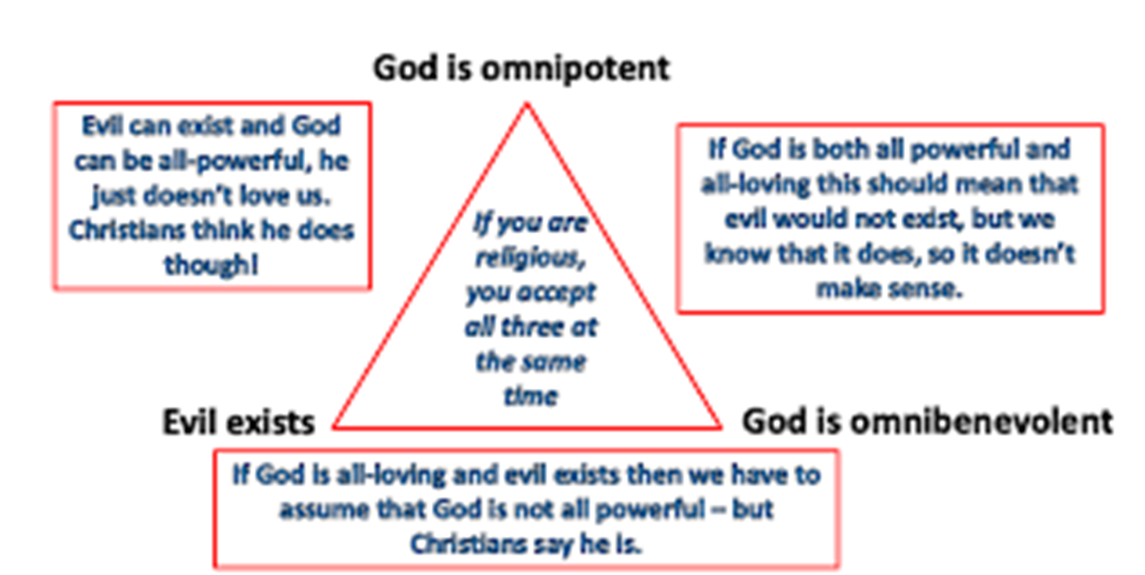
| Year 9 | Term 5 | What are issues of good and evil?
REP
KEY VOCABULARY
1 | Suffering | The state of undergoing pain, hardship or distress.
2 | Evil | Profoundly immoral and wicked (especially when attributed to a supernatural force).
3 | Omnipotent | All-powerful.
4 | Omniscient | All-knowing.
5 | Omnibenevolent | All-loving.
TYPES OF EVIL
1 | Natural Evil | Suffering caused by natural disasters.
2 | Moral Evil | Suffering caused by another human action (or inaction).
3 | Inconsistent Triad | God cannot exist if he is all powerful and all loving with evil is still in the world. – surely, he would get rid of it.
STORIES OF GOOD AND EVIL
1 | The Fall | The story of Adam and Eve – the original sin.
2 | Pandora's Box | A box opened by Pandora that cursed humankind.
GENOCIDE IN THE MODERN WORLD
1 | Free Will | God gave us the option to make our own decisions.
2 | Theodicy | An argument that suggests that it is acceptable logic to say that suffering exists, but God still loves His people.
3 | Irenaeus | Suffering and evil are useful as they help our knowledge increase.
4 | Augustine | Evil is not a thing but is an absence of Good.

Slide 12
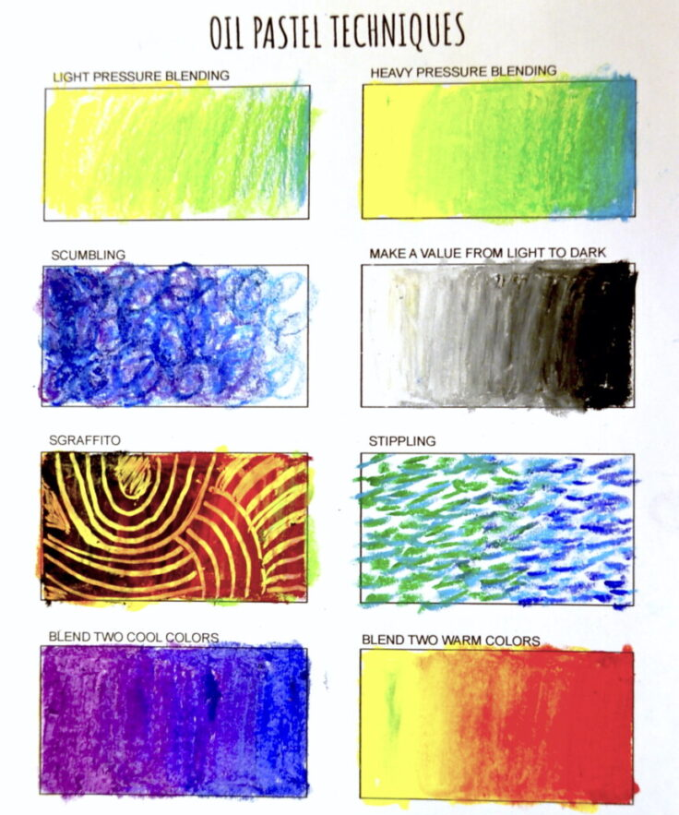
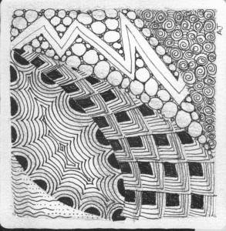
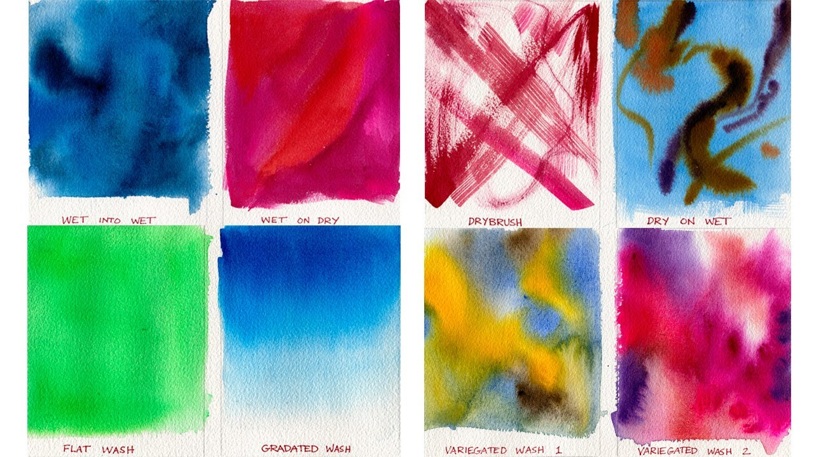
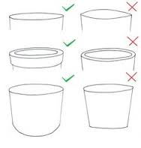
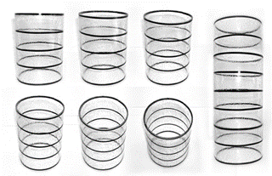
| Year 9 | Term 5 |How can distortion be used in Art?
ART
KEY VOCABULARY
1 | Mind-map | A diagram in which information is represented visually, usually with a central idea placed in the middle and associated ideas arranged around it.
2 | Composition | How an image is arranged.
3 | Media | The types of materials used to make a piece of artwork, e.g. paint, pencil, ink.
4 | Develop | To generate ideas on a starting point.
5 | Experimentation | To try out different materials and techniques for your work.
6 | Ellipse | The shape when a circle is viewed in perspective.
MATERIALS AND TECHNIQUES
1 | Zentangle | A drawing process where decorative shapes and patterns are used.
2 | Oil pastels | Bright and bold colour. Can be applied in different ways. including blending and sgraffito.
3. | Watercolour | Good for applying washes of colour to a large area Not good for fine detail.
4 | Colouring pencils | Good for intricate detail and small areas. Can be used to add finer details over the top of paint.
5 | Mixed media | Where different materials are combined together to create a piece of work.
SENTENCE STARTERS FOR WRITING ABOUT YOUR OWN WORK
1 | I have drawn this because…
2 | I have used these materials…. because they are good for…
3 | I think it is successful because…..
4 | I think it could be improved by…
HOW TO DRAW AN ELLIPSE

Slide 13
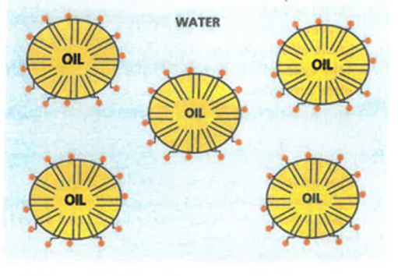
FOOD TECHNOLOGY
| Year 9 | Term 5 |WHAT IS A CUISINE?
KEY VOCABULARY
1 | Cuisine | A style of cooking of a particular country or region.
2 | Immiscible | Where two liquids do not mix, e.g. oil and water.
3 | Emulsification | When two unmixable liquids are forced together, tiny droplets of one will spread throughout the second liquid.
4 | Emulsifier | An ingredient added to an emulsion to make it stable. E.g. egg yolk.
TRADITIONAL BRITISH PRODUCE
1 | Vegetables | Potatoes Leeks Parsnips Sprouts
2 | Herbs | Mint Chives Sage
3 | Meat | Lamb Pork Bacon Poultry
4 | Dairy | Cheddar cheese Milk Double Gloucester cheese
5 | Fish | Mackerel Cod Haddock Salmon
INTERNATIONAL CUISINE & INGREDIENTS
1 | Italy | Bread Olives Tomatoes Gnocchi Arborio Rice
2 | India | Wheat Rice Spices; cumin, turmeric, chilli Naan Samosas Kulfi
3 | Spain | Paella Frittata Tapas Churros
4 | China | Fish and seafood Rice Soups and Broths
EATING PATTERNS IN THE UK
1 | Breakfast | This is the first meal of the day. A cooked English breakfast of bacon, eggs, sausage, grilled tomato, mushroom is traditional, but not normally eaten every day. We tend to eat cereals, yoghurt, fruit, toast or porridge for breakfast.
2 | Elevenses | A mid-morning snack. Food such as fruit, nuts, seeds, biscuits can be eaten.
3 | Lunch | Most people have a light, quick lunch – such as a sandwich, soup or salad. The exception is on a Sunday, when some have a roast meal.
4 | Tea | Tea is often a snack. Afternoon tea is popular in tearooms and cafes. It consists of a pot of tea with a selection of small sandwiches, pastries and cakes.
5 | Dinner | A meal eaten in the evening – sometimes this is called supper or tea.
EMULSIFICATION
1 | Oil and water do not mix. They are immiscible.
2 | When 2 un-mixable liquids are mixed together tiny droplets of one will spread throughout the second liquid, forming an emulsion.
3 | An emulsifier can be added to make the 2 un-mixable liquids stable.
4 | Red dot – hydrophilic head which is attracted to water. Black tail – hydrophobic – hates the water and is attracted to the oil.

Slide 14
| Year 9 | Term 5 |What are design movements and how can they influence your work?
TECHNOLOGY
KEY VOCABULARY
1 | Design Movement | A Design movement is the collective title given to a group of artefacts/artworks that share the same ideals, style or technical approach.
2 | Chronological | A record of events in the order in which they occurred.
3 | 2D design | Software which allows you to draw digitally.
4 | Net | A net is what a 3D shape would look like if it was unfolded.
5 | Laser cutter | As the name suggests, laser cutters create patterns and designs by cutting into materials. A powerful laser beam is the source that melts, burns, or vaporizes the material.
6 | CAD | Computer Aided Design.
7 | CAM | Computer Aided Manufacture.
8 | LED | A light emitting diode.
9 | Soldering | Soldering is a joining process used to join different types of metals together by melting solder. Solder is a metal alloy usually made of tin and lead which is melted using a hot iron. The iron is heated to temperatures above 600 degrees Fahrenheit which then cools to create a strong electrical bond.
KEY DESIGN MOVEMENTS & INFLUENCES
1 | Art Nouveau | Linear patterns of Japanese prints. French Post-impressionist art. Arts and Crafts Movement.
2 | Art Deco | End of WW1, growth of mass production. Range of international styles coming into the public eye.
3 | De Stijl | Means ‘The Style’ in Dutch. Reaction against the decorative art deco.
4 | Memphis | Rebelling against functional modernism. Art Deco. Pop Art.
KEY DESIGNERS & FEATURES OF THEIR WORK
1 | Art Nouveau | Alphonse Mucha. Louis Comfort Tiffany. Charles Rennie Macintosh. | Floral and decorative patterns. Elegant and graceful lines. Use of traditional materials.
2 | Art Deco | Claric Cliff. Eileen Gray. Rene Lalique. Walkter Dorwin Teague. | Stylised geometric shapes. Bold colours often paired with black, chromes and metallic. Sunburst motifs.
3 | De Stijl | Theo van doesburg. Piet Mondrian. | Simple. Primary colours. Geometric forms.
4 | Memphis | Ettore Sottsass. Michele De Lucchi. Martine Bedine. | Less is Bore principles. Post-modernism design. Bright, colourful and sculptural design. Simple and Abstract forms. Use of non-traditional materials.

Slide 15
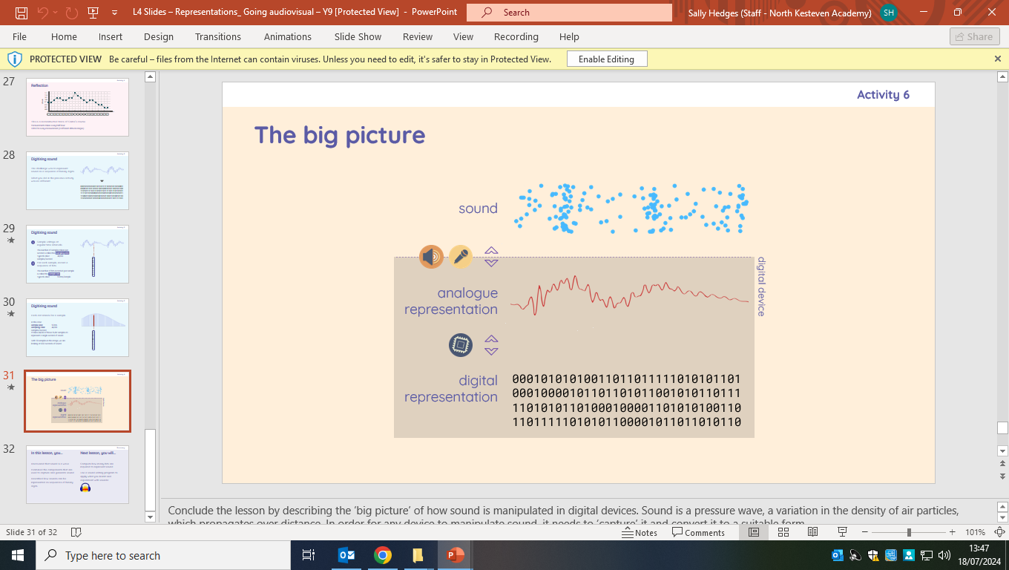
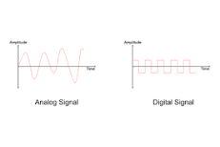
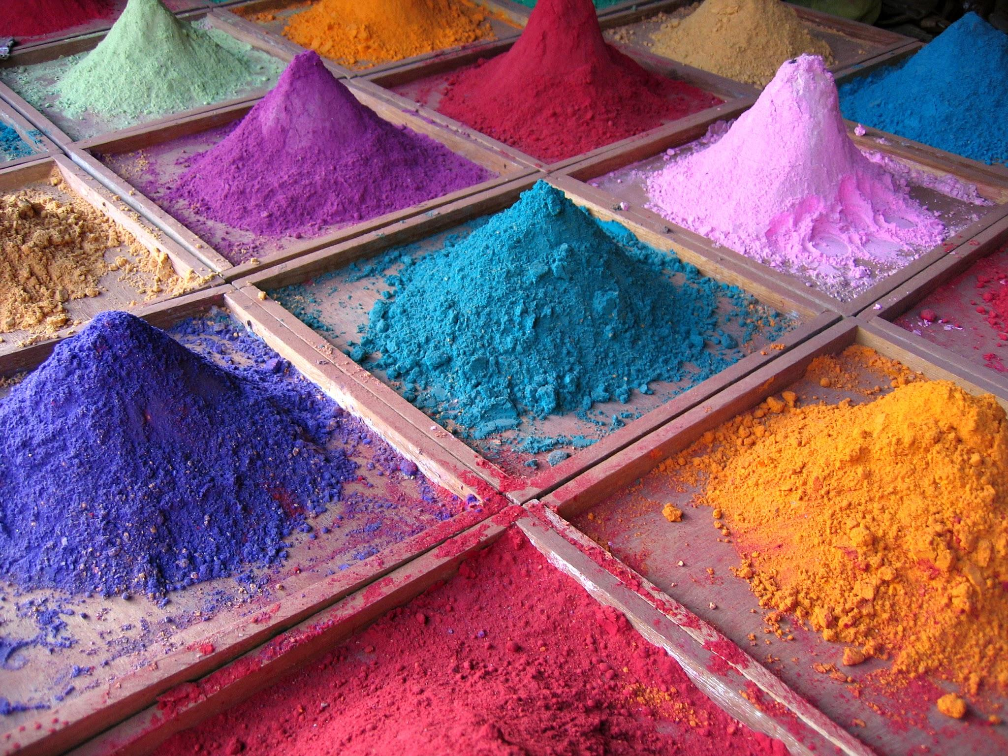
| Year 9 | Term 4 | How does the computer process sound?
COMPUTING
SOUND TYPES
AUDIO REPRESENTATION KEY WORDS
1 | Digital | Digital data is the electronic representation of information in a format or language that machines can read and understand.
2 | Analogue | Analogue is sound that you can her when a person speaks. If this is captured on a device and processed onto a computer, it becomes digital.
3 | Resolution | The number of pixels that exist within that image. The higher the resolution, and the richer the pixel count, the more detail and definition you will see.
4 | Bits | One binary bit (is the smallest value of data).
5 | Sampling | Taking binary bits of sound to recreate a copy of the original sound.
6 | Sample Rate | The number of samples taken per second is called the sampling rate .
7 | Sample Size | To make a copy or have extra data that is the same.
8 | Sound Editor | Software used to convert and edit sound.
9 | Bitmap Image | A photographic image that uses pixels to sequence an image.
10 | Vector Graphics | Images can be represented as collections of geometrical shapes (each with its own attributes).
In order for any device to manipulate sound, it needs to ‘capture’ it and convert it to a suitable form.
Microphones are used to convert sound waves to variations in electric voltage that mirror the variations in air pressure. The electric signal that is produced is an analogue representation of sound.
ANALOGUE VERSUS DIGITAL
Digital signals are transmitted as 1s and 0s, whereas analogue signals are transmitted in waves. One is not necessarily better than another, but one may be preferred over the other depending on the situation.
AUDIO REPRESENTATION KEY WORDS
1 | Red | 255, 0, 0
2 | Green | 0, 255, 0
3 | Blue | 0, 0, 255

Slide 16
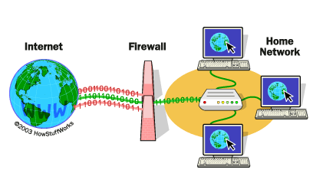
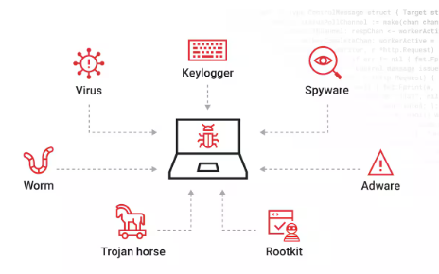
| Year 9 | Term 5 | How long would it take for someone to crack your password?
COMPUTING
Cyber Security Key Words | Cyber Security Key Words
1 | Data Protection Act | Controls how personal information can be used and your rights to ask for information about yourself.
2 | Social Engineering | Manipulating, influencing, or deceiving a victim in order to gain control over a computer system, or to steal personal and financial information.
3 | Phishing | Phishing is when attackers send scam emails (or text messages) that contain links to malicious websites.
4 | DDoS | Distributed Denial of Service Attack. The attacker floods a server with internet traffic to prevent users from accessing connected online services and sites.
5 | Internet Bots | Bots are automated programs that perform tasks repeatedly.
6 | Penetration Testing | A security exercise where a cyber-security expert attempts to find and exploit vulnerabilities in a computer system.
7 | Fire Wall | A firewall is a security system designed to prevent unauthorised access into or out of a computer network.
8 | User permissions | Different levels of access to data/information or network permissions.
9 | Biometrics | Biometric authentication refers to a cybersecurity process that verifies a user's identity using their unique biological traits such as fingerprints, voices, retinas, and facial features.
10 | CAPTCHA | CAPTCHA (Completely Automated Public Turing test to tell Computers and Humans Apart) is a type of security measure known as challenge-response authentication.
A Fire Wall
Firewalls are used to check data packets as they are sent to or received from a system or network.
A firewall can be used to:
check that incoming packets meet specific rules before being allowed in.
set rules about which stations on a network can send or receive packets.
Malware
Malware (malicious software) is software that is designed to gain access to your computer with malicious intent.
There are different types of malware from viruses to trojan horses and keylogging software.

Slide 17
YEAR 9 | TERM 5 | CAN I USE PERFORMANCE AND DESIGN SKILLS TO BRING BLOOD BROTHERS TO LIFE?
DRAMA
KEY PERFORMANCE SKILLS
1 | Vocal Expression | Using voice (tone, pitch, pace, and accent) to convey character and emotion.
2 | Physicality and Movement | Using body language, gestures, and posture to show character and age.
3 | Characterisation | Creating a believable character through voice, movement, and personality.
4 | Emotional Range | Expressing different emotions convincingly to engage the audience.
5 | Interaction and Staging | Using space, positioning, and relationships to enhance storytelling.
6 | Awareness of Genre and Style | Understanding the play’s musical and social realism elements.
STRANDS OF DRAMA LESSONS
1 | Performing: Presenting your drama to an audience.
2 | Devising: Creating your own performance.
3 | Appreciation: Understanding and commenting on your own performance and the performances of others.
4 | Designing: Lighting, Sound, Costume and Set design that help create a vision.
KEY CHARACTERS
1 | Eddie Lyons | The upper-class twin raised by Mrs. Lyons. Kind, polite, and academic but naive about class struggles.
2 | Mickey Johnstone | The working-class twin who faces hardship, unemployment, and depression. Starts as playful and carefree but becomes troubled.
3 | Mrs Johnstone | A struggling working-class mother who gives one of her twin sons away due to financial hardship. Warm but superstitious.
4 | Mrs Lyons | A wealthy but lonely woman who manipulates Mrs. Johnstone into giving up one twin, later becoming paranoid and controlling.
5 | Linda | Mickey and Eddie’s childhood friend, who later becomes Mickey’s wife. Caring and loyal but caught in a tragic love triangle.
6 | Narrator | A mysterious figure who warns of fate and class conflict, reinforcing the play’s themes of destiny and tragedy.
7 | Sammy Johnstone | Mickey’s rebellious older brother, a troublemaker who turns to crime and influences Mickey.
KEY DESIGN SKILLS
1 | Set Design | Creating locations that reflect class and setting.
2 | Costume Design | Dressing characters to show personality, class, and time period.
3 | Lighting Design | Using light to create mood, focus, and atmosphere.
4 | Sound Design | Adding music and effects to enhance emotion and realism.
5 | Props and Set Dressing | Placing objects to support character and setting.
6 | Makeup and Hair Design | Styling to show age, class, and character traits.
KEY THEMES
1 | Social Class | The play highlights the stark differences between the working-class Johnstone and the middle-class Lyons, showing how social class impacts opportunities and life outcomes.
2 | Fate | The idea that Mickey and Eddie’s tragic end is inevitable, reinforced by superstition and the Narrator’s warnings.
3 | Nature/ Nurture | The play explores whether personality and success are shaped more by upbringing (nurture) or inherent traits (nature), as seen in the contrasting lives of the twins.
REHEARSAL STRATEGIES
1 | Systematic repetition
2 | Rehearsal discipline
3 | Planning of rehearsal
4 | Respond to feedback
5 | Own Research

Slide 18
DANCE
| Year 9 | Term 5 | How can we apply Fosse-style skills and techniques in performance?
PHYSICAL FEATURES OF FOSSE
1 | Isolation | Sharp, controlled movements that emphasise one body part at a time.
2 | Angular | Distinctive, exaggerated angles in the arms, legs, and body.
3 | Inward | Turned-in knees, slouched posture, and hunched shoulders create a unique silhouette.
4 | Props | Use of canes, hats, gloves, and chairs as integral parts of choreography.
5 | Finger Articulation | Expressive use of hands and fingers, such as Fosse’s signature jazz hands and boiled eggs.
6 | Catlike | Smooth, slinky transitions between movements, giving a cool, effortless feel.
7 | Percussive | Movements often sync with the rhythm of the music, emphasizing beats sharply.
8 | Stylised | A highly recognisable, theatrical aesthetic with a sleek, sensual quality.
9 | Athleticism | Powerful turns and leaps, combining grace with strength.
10 | Flexibility | Emphasis on extensions and fluid yet controlled movement.
INTERPRETIVE FEATURES OF FOSSE
1 | Focus | Intense, deliberate eye movements that enhance mystery and drama, often using downward glances or direct stares.
2 | Facial Expression | A, E, I, O and U, with hints of playfulness, mischief, or seduction to match the Fosse style.
3 | Projection | Controlled yet captivating energy that draws the audience in, often through subtle movements rather than large gestures.
4 | Dynamic Energy | Sharp, precise movements contrasted with slow, slinky transitions, creating a hypnotic effect.
5 | Sensitivity to Other Dancers | Awareness and interaction with fellow performers, often through synchronised, sharp movements, creating a sense of cohesion or contrast.
FOSSE’S INFLUENCE
1 | Innovative Choreography | Fosse revolutionised dance with his unique style, incorporating angular movements, isolations, and minimalistic gestures.
3 | Cross-genre Influence | Fosse's style has influenced genres beyond theatre, such as film, television and live.
4 | Cultural Impact | His influence extends beyond theatre into pop culture, inspiring music videos and performances by artists like Madonna and Beyoncé.
5 | Pioneering Gender Expression in Dance | He often explored themes of sexuality and gender, changing how dance was perceived in terms of gender roles.
REHEARSAL STRATEGIES
1 | Feedback and Corrections | Actively seeking and applying constructive feedback to refine technique and performance.
2 | Systematic Repetition | Repeating movements or sequences in a structured way to build muscle memory and improve precision.
3 | Breaking Down Choreography | Dividing complex movements or routines into smaller sections to focus on specific details, making it easier to learn and perfect.
4 | Partnering and Group Practice | Working with others to enhance timing, coordination, and connection in duet or group work.
5 | Mental Rehearsal | Visualising movements and performance in your mind to strengthen memory and focus, even outside of physical practice.

Slide 19
MUSIC
| Year 9 | Term 5 | What is a canon and how do I compose one?
MELODIC TERMS
1 | Motif | A melodic idea.
1 | Conjunct | A melody where notes are close to each other.
2 | Disjunct | A melody where notes are further apart.
3 | Inversion | A motif is repeated, but the intervals are turned upside-down.
4 | Sequence | A motif repeated up or down a step in pitch.
5 | Stepwise | A melody where the movement moves largely in steps.
KEY VOCABULARY
1 | Ground bass | A repeated bassline normally played on the cello or organ.
2 | Baroque | The music written between the time period of 1600 – 1750. Musical periods overlap.
3 | Canon | A piece of music where the original melody is imitated by different instruments.
4 | Imitation | Different instruments playing a similar melody. It sounds like the instruments are “chasing” each other.
5 | Call and response | An instrument plays a motif and other instruments respond in a similar way.
6 | Pachelbel | A composer who lived during the baroque period.
7 | Texture | How different musical layers interact such as melody and harmony.
NOTATION TERMS
1 | Semi-breve | A 4-beat note.
2 | Minim | A 2-beat note.
3 | Crotchet | A 1-beat note
4 | Quaver | A ½-beat note.
COMPOSING TIPS
1 | Start with a simple idea | A catchy hook which is repeated provides legitimacy.
2 | Development | Adding notes, changing rhythms, or changing the pitch of your original motif adds development over time.
3 | Use syncopation | Don’t play every note on the beat, play in between beats to add rhythmic variety.

Slide 20







FULLY UTILISE YOUR KNOWLEDGE ORGANISERS
INDEPENDENT LEARNING
Use the following templates alongside the corresponding instructions to carry out your independent work.

Slide 21


SKETCH NOTES
HOW DO I MAKE USEFUL SKETCH NOTES?
Pick a focus area for your notes – this could be a topic, theme, exam question, unit question, etc.
Make notes in a logical order but rather than making detailed written notes, use a range of the following techniques:
Use upper case (capital letters) to emphasise particular words.
Turn a words into images e.g. the A in shArk turns into a fin;
Add images and/or icons into the text;
Use diagrams and tables to break down key areas,
Use arrows and lines to link different things together;
Use different shapes, thought-bubbles, etc.
Use a range of colours to emphasise different aspects of your notes/page.
Once you have completed your sketch note page try photocopying it in black and white and then use colours to RAG-rate the information – you will then create a real focus for your revision by prioritising first the Red and then the Amber!

Slide 22

MIND MAP
HOW DO I CREATE AN EFFECTIVE MIND MAP?
Decide on the overall focus – this could be a topic/unit question, an exam question, key theme, etc – and then write this in the centre of the page.
Break this down into key areas, factors, ideas, etc and add these as main branches around the centre.
Break these main branches down further by adding more information – each main branch might break down into several more and each of these into several more.
Colour-code your branches, highlight key information and add any images, icons, diagrams, etc.
TOP TIP: Write on your branches and only use the most key information and words – this will help you to fit as much as possible on one page!
The aim of a mind-map is to fit as much as possible all on one page! Therefore, avoid writing in full sentences and focus on using the branches to organise your notes.

Slide 23
MIND MAP
HOW DO I CREATE AN EFFECTIVE MIND MAP?
Decide on the overall focus – this could be a topic/unit question, an exam question, key theme, etc – and then write this in the centre of the page.
Break this down into key areas, factors, ideas, etc and add these as main branches around the centre.
Break these main branches down further by adding more information – each main branch might break down into several more and each of these into several more.
Colour-code your branches, highlight key information and add any images, icons, diagrams, etc.
TOP TIP: Write on your branches and only use the most key information and words – this will help you to fit as much as possible on one page!
The aim of a mind-map is to fit as much as possible all on one page! Therefore, avoid writing in full sentences and focus on using the branches to organise your notes.

Slide 24

FLASH CARDS
FRONT (key term or question)
BACK (answer)
Why not RAG-rate your cards? (Red = you really don’t know, Amber = you sort of know, Green = you completely know and understand). Then, every time you re-test yourself, you can re-RAG-rate your cards. You could do this along the bottom of each card.
HOW DO I MAKE FLASH CARDS?
Think about what you want the focus of each card to be – it could be a key question, piece of vocabulary, exam question, factor, etc.
Record this on the ‘front’ card (left-hand column) – adding an image, diagram, some colour, etc, to make it memorable, is helpful. You can also number your cards.
Think about what information links to this – it could be written notes, an answer to a question, a definition, potential ideas, etc.
Record this on the ‘back card’ – try to break it down into bullet-points, use icons and imagery, colour, diagrams, once again to make it memorable.
Cut your cards out, fold the middle and glue them together – you can now use them to test yourself… or even better, get somebody else to test you.

Slide 25
WRITE LIKE AN EXPERT
HOW DO I DEVELOP MY EXPERT WRITING?
Start by putting your topic title or question as a sub-heading.
Begin by identifying the key points or aspects and writing a summary of this – think about the key vocabulary needed.
Next, try to develop these main ideas one at a time – aim to use connectives to help you do this e.g. because, therefore, so.
Now try to link these ideas to examples or evidence – you can do this separately or alongside each area in ‘step 3’.
To complete your expert piece of writing, aim to summarise the overall main point or argument or conclusions.
Talk to your teacher about the specific types of language, sentences and vocabulary that you can use to develop your ‘writing like an expert’ – this can vary from subject to subject and skill to skill (This is why teachers often provide you with sentence starters).

Slide 26
LOW STAKES QUIZZING
Why not RAG-rate your cards? (Red = you really don’t know, Amber = you sort of know, Green = you completely know and understand). Then, every time you re-test yourself, you can re-RAG-rate your cards. You could do this along the bottom of each card.
HOW DO I MAKE AN EFFECTIVE LOW-STAKES QUIZ
Choose something on your knowledge organiser and write a question where this is the answer – write this in the top box of the card.
Write 3-5 possible answers in the bottom box’ – label these with numbers or letters e.g. a) to e).
Write the correct answer on the back of the card for future reference, so that you can easily check if you were right or wrong.
Put your low-stakes quiz somewhere safe and return to it a few days/weeks later - test yourself or get somebody else to test you!

Slide 27
Build foundations first: Knowledge Organisers provide the key ‘foundations’ to a topic or unit acts as a vital reminder of the key ideas, facts, information and concepts.
Retrieve and recall: the content of Knowledge Organisers are a regular part of the starts of lessons, lesson activities and discussion, self-testing and teacher assessment.
Revise: Knowledge Organisers are a fantastic starting point for further revision - they can be used to self-test, develop revision notes, create further revision resources.
Succeed: Ultimately, knowledge is power. Utilising the content of a Knowledge Organiser will provide the power to access the next step in learning.
EMPOWERING POTENTIAL
EMPOWERING SUCCESS

