Slide 1
Welcome
Year 7 Transition Day
Parent / Carer Information Event
Thursday, 5th July 2023
Fiona McGrath, Assistant Head
Mel Hibbs, Head of Year 7
Leanne Parker, Primary Liaison &
Head’s PA

Slide 2
Aims:
To share with you what your children have been doing today on their transition day
To share answers to your children’s frequently asked questions
To clarify our expectations of you and what you can expect from us
To clarify arrangements for the first day in September

Slide 3
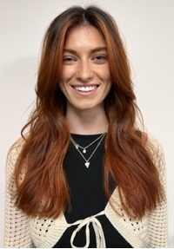
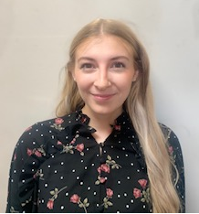
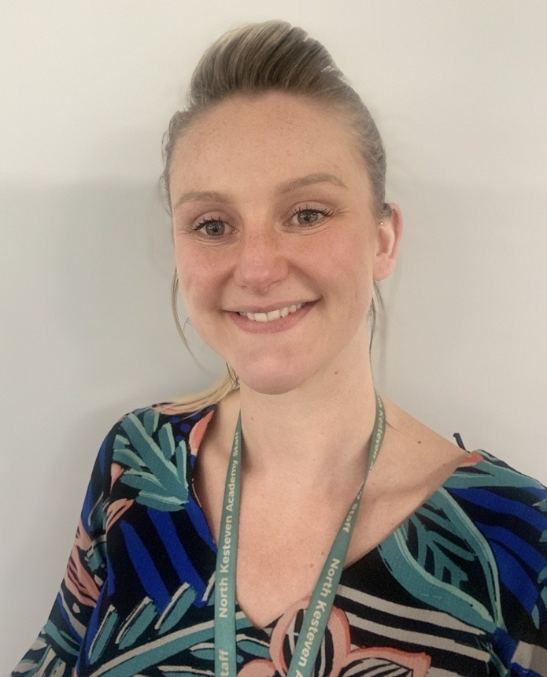
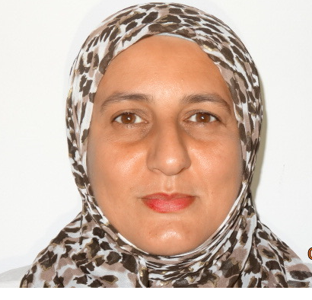
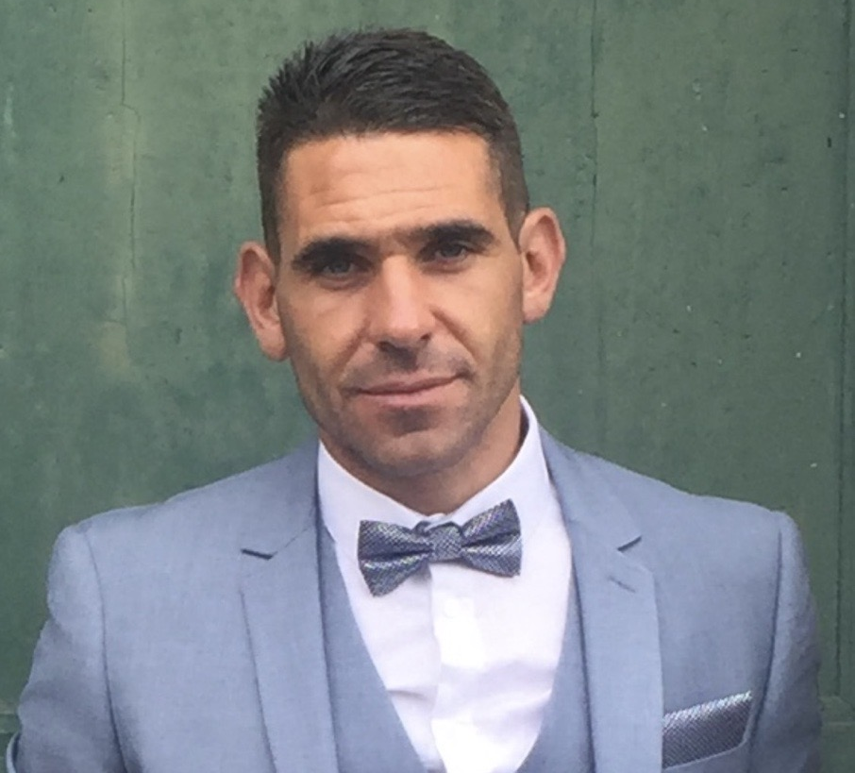
What have our new students been doing today?
Met their tutor and the rest of their tutor group
Met their Head of Year
Mrs Allen
(7AK)
Mrs Aldaman (7AR)
Mr Walters (7WG)
Miss Francombe (7FS)
Miss Markland (7MK)
Mrs Hibbs

Slide 4
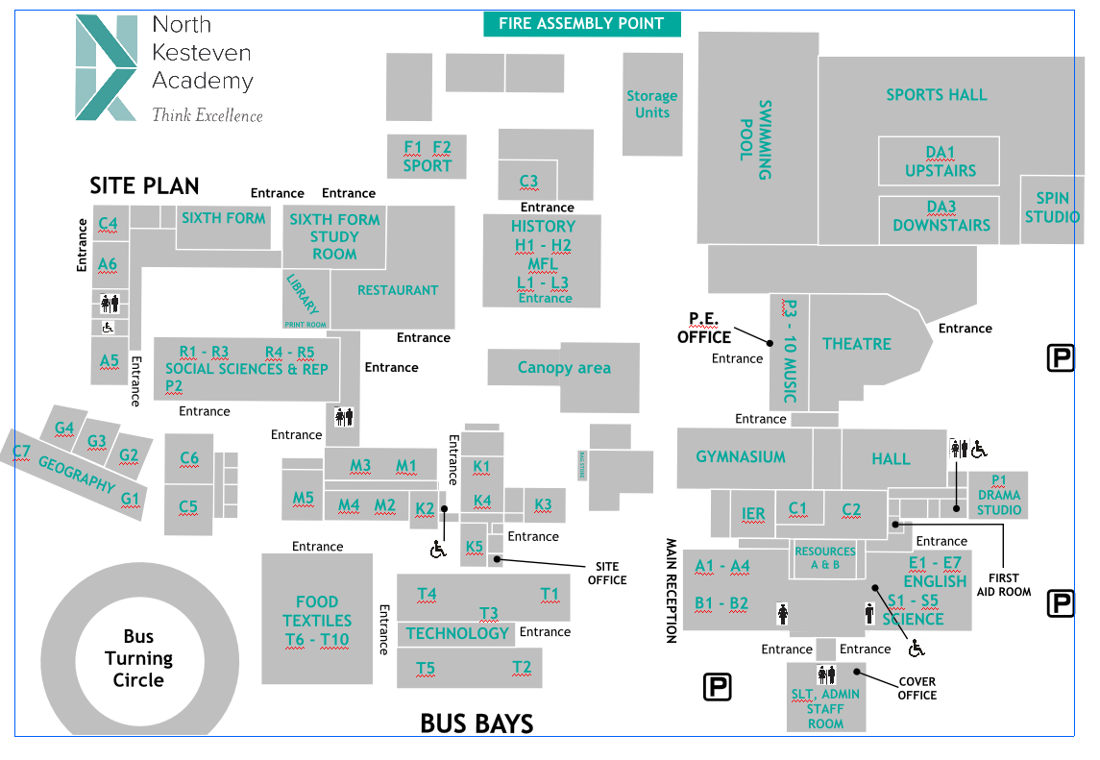
What have our new students been doing today?
Learning our routines:
line ups;
entering classrooms;
learning;
using the restaurant;
working hard.
Tour of the academy
Assembly – awards from the day
Participation in an extra-curricular activity

Slide 5
What will they come home with today?
Drawstring PE bag;
Pencil case containing basic equipment;
Information booklet including: uniform list, term dates, times of school day, contact details etc.
Their house tie;
Transition Challenges.

Slide 6
Frequently Asked Questions

Slide 7
Frequently Asked Questions:
What happens if I get lost?
Map in the diary
Subjects are taught in groups of classrooms or blocks
Timetable with room numbers
Taught as a tutor group for most lessons – if we lose a whole group, they are easy to find!
Staff and 6th form students will be on hand for the first 2 weeks to support new students to get to the right place
Reception – Mrs Chambers is the font of all knowledge!
They will soon work out where the blocks are and how to get to them

Slide 8
Frequently Asked Questions:
What is a tutor?
The tutor is the person that your child will see every day, they follow a Personal Development timetable, take the register and ensure they are ready for the day. They are the first port of call for any concerns.
What happens if someone is unkind?
Tell someone at school.
We have reminders at the beginning of the year and during the year about being kind and acts of kindness.
Everyone signs up to an anti-bullying pledge.

Slide 9
Frequently Asked Questions:
Can my child bring a mobile phone to school?
They can bring it but we expect it to be switched off and away as they enter the gate until they leave at the end of the day.
We will confiscate it if we see or hear it during the day.
How many lessons are there in the day?
5 lessons per day
How long are the lessons?
1 hour

Slide 10
Frequently Asked Questions:
How long are breaks?
Break is 20 minutes
Lunch is 35 minutes
How does my child buy food in the restaurant?
If you have given us permission to do so, we have scanned your child’s finger print today
Parents preload the account using ParentPay online (your child has a letter about this to bring home today)
No cash is accepted in the restaurant
Their finger is scanned at the checkout in the restaurant.
If accounts are running low on funds the restaurant staff will ask the students to ask at home to top up.
We will not let them go hungry if they go into the red!

Slide 11
Frequently Asked Questions:
What sort of bag should I have?
A rucksack is recommended.
Can my child have a locker?
Yes if they would like one, please contact our Finance Office.
Deposit of £5 required
Remember the children will be walking from lesson to lesson and their locker will be static!

Slide 12
Frequently Asked Questions:
What lessons will Y7 do?
In Years 7, 8 and 9:
English
Maths
Science – Biology, Chemistry, Physics
History
Geography
German
Religion, Ethics, Philosophy (REP)
Art
Technology – 3D Design and Food
Music
Dance
Drama
Computing (Information Technology)
Physical Education

Slide 13
Frequently Asked Questions:
What are houses?
Each tutor group (and each student within it) are allocated to a house:
Each house has an emblem, this appears on their tie.
Lots of competitions and charity work throughout the year through our house system.
7AR RUSTON
7WG SWIFT
7AK SWIFT
7FS BOOLE
7MK TENNYSON

Slide 14
Frequently Asked Questions:
How do rewards work?
Teachers and other staff will award points via our Epraise system for a variety of different reasons which might include:
Excellent work/achievement
Working hard and persevering
Helping someone
Community work
Participating in an activity
Points add up for the individual and contribute to the house total.
Every student and parent get a login to keep track and for students to use the Epraise shop to spend their points.

Slide 15
What can you expect from us?
Quality educational provision;
High expectations of your child;
Ready, respectful, safe as central to our behaviour policy;
Open and honest communication;
We will let you know when your child does something really well;
If there’s a problem, we will tell you as soon as possible;
Regular information via email;
Communication via the student diary.

Slide 16
Our expectations of you:
Open and honest communication.
If there’s a problem, tell us as soon as possible.
If we’re doing something really well, tell us – your feedback is valuable to us.
Read emails regularly and follow us on social media so you are well informed.
Ensure your child is ready for school every day: uniform and basic equipment.
Look at your child’s diary every week.

Slide 17
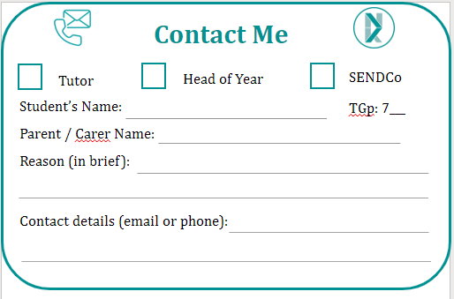
What happens next?
Complete a Contact Me slip if you would like contact before the end of term from your child’s tutor, Head of Year or our SENDCo
Collect your children from under the canopy
Key staff will be available to ask any individual questions under the canopy
Get ready to come in September – uniform, equipment
Transition Challenges – all directly linked to what they will be learning in September. Every task will earn praise points.

Slide 18
What happens next?
First day for all students is Wednesday 6th September
Come in NK uniform
Gates open at 8.30am
8.45am start
3.15pm finish
First 2 weeks – Year 7 will start lunch earlier to get used to the restaurant
SEND Parent / Carer Event: Tuesday 12th September 4:15pm
Settling in evening in October: but don’t wait until then to tell us anything you want to tell us

